Slide 1
UPPER SIXTH ARTS
GEOGRAPHY
Lesson 24
Other Theories of Industrial Location: Lösch and Smith
Notes:
Good morning, class, and welcome to our geography lesson. I am your geography teacher, Mr Kamdem. Today we are starting Lesson 24: Other Theories of Industrial Location: Lösch and Smith.

Slide 2
CLASS INFO
Class, Chapter and Duration
Class | Upper Sixth Arts
Chapter | Module 6: Understanding and managing the dynamics of economic activities across the world in general and Cameroon in particular
Duration | 2 periods (2 × 50 minutes)
Notes:
This lesson is for Upper Sixth Arts. It belongs to Module 6: Understanding and managing the dynamics of economic activities across the world in general and Cameroon in particular. We shall need 2 periods to cover it.

Slide 3
IDENTIFICATION
Lesson Identification
Topic | Theories of Industrial Location
Sub-topic | Theories of Industrial Location
Lesson | Lesson 24: Other Theories of Industrial Location: Lösch and Smith
Notions / Concepts | Lösch, market area, maximum revenue, D. M. Smith, space-cost curve, spatial margins of profitability.
Syllabus focus | Lösch's market area theory; D. M. Smith's space-cost theory.
Competence | Learners are able to explain and compare Lösch's and Smith's theories.
Notes:
Our topic is Theories of Industrial Location, and the sub-topic is Theories of Industrial Location. The key notions we shall use today are: lösch, market area, maximum revenue, D. M. Smith, space-cost curve, spatial margins of profitability. At the end, you should be able to do this: learners are able to explain and compare Lösch's and Smith's theories.

Slide 4

HOMEWORK CORRECTION
Correction of the Homework
Question (Practical Work 3: Material Index, Location Triangles and Isodapanes):
Calculate ton-kilometres for three sites and choose the least-cost site.
Notes:
Before we start the new lesson, let us correct the homework I gave you at the end of Practical Work 3: Material Index, Location Triangles and Isodapanes. The question was: Calculate ton-kilometres for three sites and choose the least-cost site. Take out your exercise books.

Slide 5
HOMEWORK CORRECTION
Correction: Possible Answer
Example: site A = 2 × 30 + 1 × 20 = 80 ton-km; site B = 2 × 10 + 1 × 40 = 60 ton-km; site C = 2 × 20 + 1 × 30 = 70 ton-km. Site B is the least-cost site.
Notes:
Here is a good answer. Example: site A = 2 × 30 + 1 × 20 = 80 ton-km; site B = 2 × 10 + 1 × 40 = 60 ton-km; site C = 2 × 20 + 1 × 30 = 70 ton-km. Site B is the least-cost site. Compare it with your own answer and correct your work in red.

Slide 6
LESSON PLAN
Lesson Plan
Correction of the homework
Objectives and recall
Real-life situation and action to take
Learning activities
Board summary
Evaluation, remediation and homework
Notes:
Here is the plan of our lesson today. First, we shall correct the homework. Then we shall look at the objectives and recall what you already know. After that, we shall study a situation from real life and the action to take, and do the learning activities. Finally, we shall copy the board summary, do the evaluation and the remediation, and I will give you the homework.

Slide 7
OBJECTIVES
Objectives
By the end of this lesson, you should be able to:
Explain Lösch's market area theory.
Explain Smith's spatial margins of profitability.
Compare them with Weber.
Notes:
By the end of this lesson, you should be able to do three things. Number 1: explain Lösch's market area theory. Number 2: explain Smith's spatial margins of profitability. Number 3: compare them with Weber.

Slide 8
PREVIOUS KNOWLEDGE
Previous Knowledge
Weber sought the least-cost location.
Christaller used hexagons.
Notes:
Let us first remember what you already know. Weber sought the least-cost location. Christaller used hexagons. Keep this in mind, because we shall build on it today.

Slide 9
REAL-LIFE SITUATION
Situation in Real Life
Two bakeries sell bread in a town. One is in the centre where many customers pass; the other on the edge where rent is cheap. Both make a profit. A learner asks if there is only one best location.
Notes:
Listen carefully to this situation from real life. Two bakeries sell bread in a town. One is in the centre where many customers pass; the other on the edge where rent is cheap. Both make a profit. A learner asks if there is only one best location. Think about it, because I am going to ask you some questions.

Slide 10
REAL-LIFE SITUATION
Situation: Question 1
What is the problem in the situation?
Notes:
Question 1: What is the problem in the situation? Think for a moment, then raise your hand to answer.

Slide 11
REAL-LIFE SITUATION
Answer
Firms can make profit in several places.
Notes:
Good. Firms can make profit in several places.

Slide 12
REAL-LIFE SITUATION
Situation: Question 2
Which theory says profit is possible in a zone?
Notes:
Question 2: Which theory says profit is possible in a zone? Think for a moment, then raise your hand to answer.

Slide 13
REAL-LIFE SITUATION
Answer
Smith's spatial margins of profitability.
Notes:
Good. Smith's spatial margins of profitability.

Slide 14
REAL-LIFE SITUATION
Situation: Question 3
Which theory focuses on sales?
Notes:
Question 3: Which theory focuses on sales? Think for a moment, then raise your hand to answer.

Slide 15
REAL-LIFE SITUATION
Possible Answer
Lösch's market area theory.
Notes:
Good. Lösch's market area theory.

Slide 16
ACTION TO TAKE
Action to Take
Compare location theories to understand real industrial choices.
Notes:
From this situation, the action we are working towards in this lesson is the following: compare location theories to understand real industrial choices.

Slide 17
JUSTIFICATION
Justification of the Lesson
This lesson helps us to see industrial location from the side of demand and profit.
Notes:
Why is this lesson important for you? This lesson helps us to see industrial location from the side of demand and profit.

Slide 18
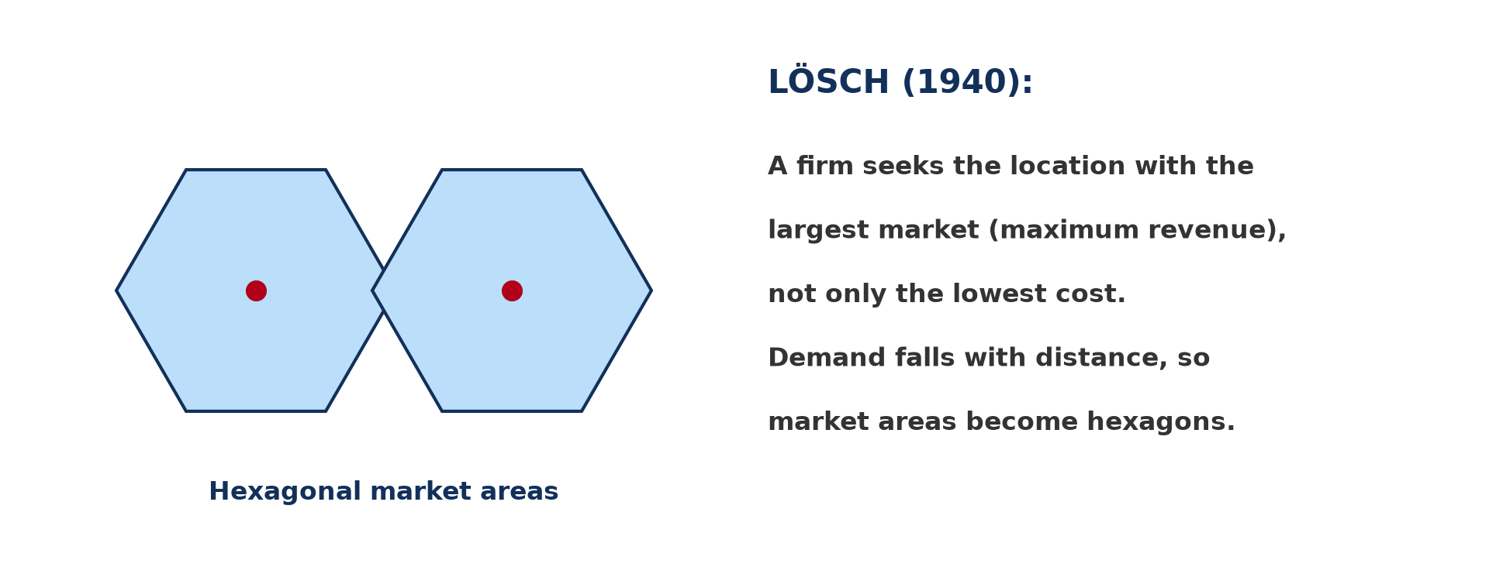
1. LÖSCH'S MARKET AREA THEORY
Activity 1
Lösch's market areas.
Notes:
Activity 1. Look carefully at this diagram: lösch's market areas. Observe every detail before I ask the question.

Slide 19
1. LÖSCH'S MARKET AREA THEORY
Activity 1: Question
What did Lösch seek?
Notes:
Here is the question for Activity 1: What did Lösch seek? Take one minute to think and write your answer in your rough notebook.

Slide 20
1. LÖSCH'S MARKET AREA THEORY
Activity 1: Answer
The location of maximum revenue (largest market).
Notes:
Let us check the answer together. The location of maximum revenue (largest market).

Slide 21
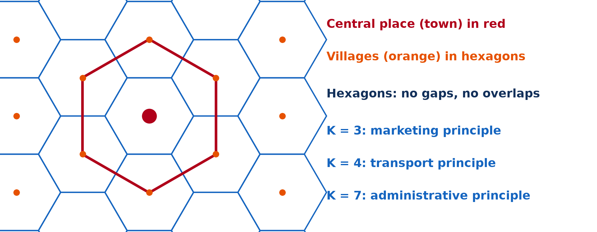
1. LÖSCH'S MARKET AREA THEORY
Activity 2
Hexagonal market areas.
Notes:
Activity 2. Look carefully at this diagram: hexagonal market areas. Observe every detail before I ask the question.

Slide 22
1. LÖSCH'S MARKET AREA THEORY
Activity 2: Question
Why are Lösch's market areas hexagons?
Notes:
Here is the question for Activity 2: Why are Lösch's market areas hexagons? Take one minute to think and write your answer in your rough notebook.

Slide 23
1. LÖSCH'S MARKET AREA THEORY
Activity 2: Answer
Demand falls with distance and hexagons cover space with no gaps.
Notes:
Let us check the answer together. Demand falls with distance and hexagons cover space with no gaps.

Slide 24
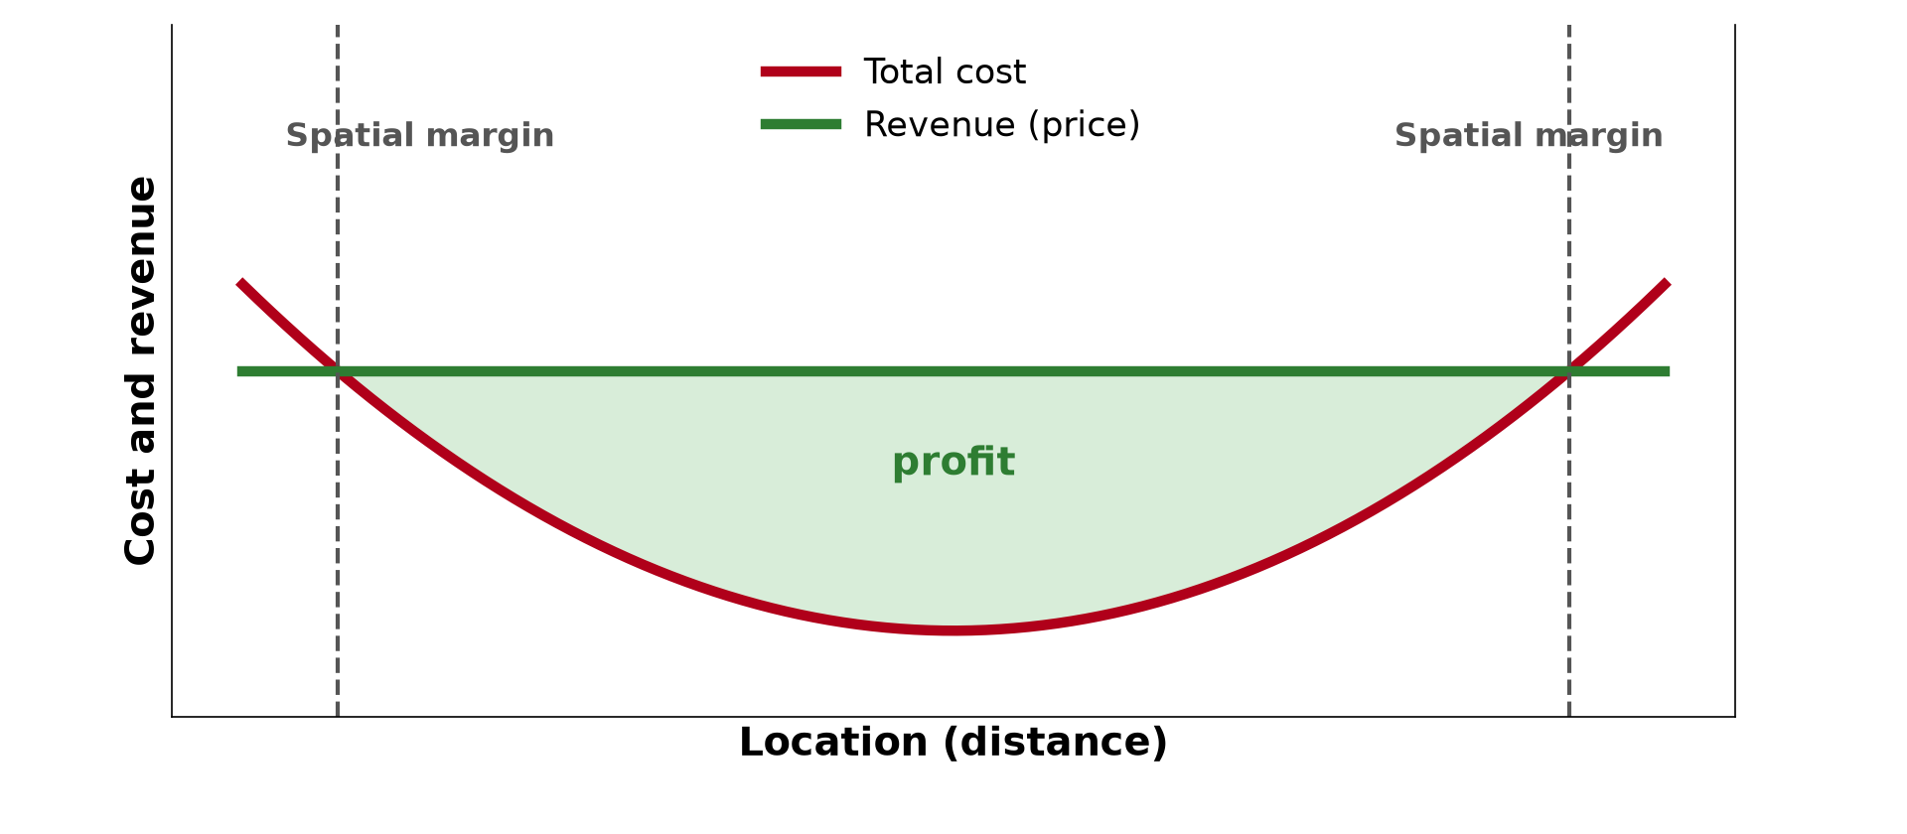
2. SMITH'S SPACE-COST THEORY
Activity 3
Spatial margins of profitability.
Notes:
Activity 3. Look carefully at this diagram: spatial margins of profitability. Observe every detail before I ask the question.

Slide 25
2. SMITH'S SPACE-COST THEORY
Activity 3: Question
What are the spatial margins of profitability?
Notes:
Here is the question for Activity 3: What are the spatial margins of profitability? Take one minute to think and write your answer in your rough notebook.

Slide 26
2. SMITH'S SPACE-COST THEORY
Activity 3: Answer
The limits of the area where revenue is greater than cost.
Notes:
Let us check the answer together. The limits of the area where revenue is greater than cost.

Slide 27

2. SMITH'S SPACE-COST THEORY
Activity 4
A modern firm.
Notes:
Activity 4. Look carefully at this picture: a modern firm. Observe every detail before I ask the question.

Slide 28
2. SMITH'S SPACE-COST THEORY
Activity 4: Question
Why does Smith's theory explain sub-optimal locations?
Notes:
Here is the question for Activity 4: Why does Smith's theory explain sub-optimal locations? Take one minute to think and write your answer in your rough notebook.

Slide 29
2. SMITH'S SPACE-COST THEORY
Activity 4: Answer
A firm can make profit anywhere inside the margins, not only at the best point.
Notes:
Let us check the answer together. A firm can make profit anywhere inside the margins, not only at the best point.

Slide 30

3. COMPARISON
Activity 5
Weber's triangle.
Notes:
Activity 5. Look carefully at this diagram: weber's triangle. Observe every detail before I ask the question.

Slide 31
3. COMPARISON
Activity 5: Question
Compare Weber, Lösch and Smith.
Notes:
Here is the question for Activity 5: Compare Weber, Lösch and Smith. Take one minute to think and write your answer in your rough notebook.

Slide 32
3. COMPARISON
Activity 5: Answer
Weber: least cost. Lösch: maximum revenue. Smith: profit zone between margins.
Notes:
Let us check the answer together. Weber: least cost. Lösch: maximum revenue. Smith: profit zone between margins.

Slide 33
BOARD SUMMARY
Board Summary
Topic: Theories of Industrial Location
Sub-topic: Theories of Industrial Location
Lesson 24: Other Theories of Industrial Location: Lösch and Smith
Notes:
Now we are going to copy the board summary. Write the title and the headings neatly in your notebooks. I will give you enough time for each slide, so do not rush.

Slide 34
BOARD SUMMARY
1. Lösch's Market Area Theory (1940)
August Lösch's theory states that:
Aim and principle: A firm seeks the location with the largest market and maximum revenue, not only the lowest cost. Demand falls with distance from the factory.
Notes:
Let us copy Lösch's Market Area Theory (1940). August Lösch's theory states that. On this slide we have Aim and principle. Write each point on a new line, with the key term first, and explain it in your own words when we revise. When you finish, we go to the next slide.

Slide 35
BOARD SUMMARY
1. Lösch's Market Area Theory (1940) (continued)
Market areas: Market areas of competing firms become hexagons that cover the space without gaps. Industries therefore locate in a regular pattern.
Criticisms: It assumes a uniform plain and equal demand everywhere. It ignores differences in costs between places.
Notes:
We continue with Lösch's Market Area Theory (1940). On this slide we have Market areas and Criticisms. Write each point on a new line, with the key term first, and explain it in your own words when we revise.

Slide 36
BOARD SUMMARY
1. Lösch's Market Area Theory (1940)
Illustration: Lösch's hexagonal market areas
Notes:
Now draw this illustration in your notebook: lösch's hexagonal market areas. Give it a title and label it clearly.

Slide 37
BOARD SUMMARY
2. Smith's Space-Cost Theory (1966)
David M. Smith's theory states that:
Principle: Both costs and revenues vary in space. A firm can make a profit anywhere where revenue is greater than cost.
Notes:
Let us copy Smith's Space-Cost Theory (1966). David M. Smith's theory states that. On this slide we have Principle. Write each point on a new line, with the key term first, and explain it in your own words when we revise. When you finish, we go to the next slide.

Slide 38
BOARD SUMMARY
2. Smith's Space-Cost Theory (1966) (continued)
Spatial margins of profitability: The margins are the limits beyond which the firm makes a loss. Inside them there is an optimum point but also many sub-optimal profitable locations.
Notes:
We continue with Smith's Space-Cost Theory (1966). On this slide we have Spatial margins of profitability. Write each point on a new line, with the key term first, and explain it in your own words when we revise. When you finish, we go to the next slide.

Slide 39
BOARD SUMMARY
2. Smith's Space-Cost Theory (1966) (continued)
Strengths: It is realistic and explains why firms are not always at the best location. Personal choice and government aid can move firms within the margins.
Notes:
We continue with Smith's Space-Cost Theory (1966). On this slide we have Strengths. Write each point on a new line, with the key term first, and explain it in your own words when we revise.

Slide 40
BOARD SUMMARY
2. Smith's Space-Cost Theory (1966)
Illustration: Smith's spatial margins of profitability
Notes:
Now draw this illustration in your notebook: smith's spatial margins of profitability. Give it a title and label it clearly.

Slide 41
BOARD SUMMARY
3. Comparison of Theories
The three theories can be compared as follows:
Weber and Lösch: Weber looks for the least-cost location, while Lösch looks for the maximum-revenue location. Both assume a uniform plain.
Notes:
Let us copy Comparison of Theories. The three theories can be compared as follows. On this slide we have Weber and Lösch. Write each point on a new line, with the key term first, and explain it in your own words when we revise. When you finish, we go to the next slide.

Slide 42
BOARD SUMMARY
3. Comparison of Theories (continued)
Smith: Smith combines cost and revenue and accepts sub-optimal locations. His theory is closest to reality.
Notes:
We continue with Comparison of Theories. On this slide we have Smith. Write each point on a new line, with the key term first, and explain it in your own words when we revise.

Slide 43
FORMATIVE EVALUATION
Evaluation 1
Compare the approaches of Weber and Lösch.
Notes:
Now let us check what you have understood. Question 1: Compare the approaches of Weber and Lösch. Answer in your exercise book.

Slide 44
FORMATIVE EVALUATION
Expected Answer
Weber: least cost. Lösch: maximum revenue.
Notes:
The expected answer is: weber: least cost. Lösch: maximum revenue. If you got it right, well done.

Slide 45
FORMATIVE EVALUATION
Evaluation 2
Explain Smith's spatial margins of profitability.
Notes:
Now let us check what you have understood. Question 2: Explain Smith's spatial margins of profitability. Answer in your exercise book.

Slide 46
FORMATIVE EVALUATION
Expected Answer
The limits of the zone where revenue exceeds cost; profit is possible anywhere inside.
Notes:
The expected answer is: the limits of the zone where revenue exceeds cost; profit is possible anywhere inside. If you got it right, well done.

Slide 47
REMEDIATION
Remediation
Fill in the blanks:
Lösch sought maximum ______.
Smith's profit zone lies between the spatial ______.
Weber sought least ______.
Notes:
For those who need more practice, fill in the blanks in your exercise book. The answers are: number 1, revenue; number 2, margins; number 3, cost.

Slide 48
HOMEWORK
Homework
Make a table comparing Weber, Lösch and Smith.
Notes:
For your homework: Make a table comparing Weber, Lösch and Smith. We shall correct it at the beginning of our next lesson.

Slide 49
NEXT LESSON
Next Lesson
Our next lesson will be on:
Lesson 25: Sub-optimal Industrial Location
Notes:
Our next lesson will be on Lesson 25: Sub-optimal Industrial Location. Thank you for your attention, and see you next time.

Slide 50
BILINGUAL GAME
Bilingual Game (Jeu Bilingue)
English | Français
Revenue | Le revenu (recette)
Profit | Le profit
Margin | La marge
Demand | La demande
Market area | La zone de marché
Theory | La théorie
Notes:
Let us play the bilingual game. I say a word in English, and you give me the French word. Then we do the reverse.

Slide 51
LOGBOOK
Official Logbook (1/2)
Module / Topic | Theories of Industrial Location
Lesson Title | Lesson 24: Other Theories of Industrial Location: Lösch and Smith
Expected Learning Outcomes | Explain Lösch's market area theory. Explain Smith's spatial margins of profitability. Compare them with Weber.
Competence | Learners are able to explain and compare Lösch's and Smith's theories.
Notes:
I record this information in the official logbook of the class after the lesson.

Slide 52
LOGBOOK
Official Logbook (2/2)
Matter Taught | Lösch's Market Area Theory (1940); Smith's Space-Cost Theory (1966); Comparison of Theories.
Evaluation | Formative evaluation and remediation exercise.
Homework | Make a table comparing Weber, Lösch and Smith.
Enrolment / Present / Absent | ____ / ____ / ____
Achievement | To be completed after the lesson.
Notes:
I complete the second page of the logbook: the matter taught, the evaluation, the homework and the attendance.

Slide 53
TEACHER'S NOTE
Teacher's Note
Timing: Homework correction, plan, objectives 8 min | Recall, situation, action 10 min | 5 activities 30 min | Board summary (copying) 30 min | Evaluation, remediation 10 min | Homework, next lesson 5 min | Logbook 7 min
Without the projector (Activity 1): draw the hexagons.
Without the projector (Activity 2): compare with Christaller.
Without the projector (Activity 3): draw the curves.
Without the projector (Activity 4): discuss choices.
Without the projector (Activity 5): make a table.
Notes:
This slide is for me, the teacher: it gives the timing of the lesson and what to do if the projector is not available.

Slide 54
REFERENCES
References
National Geography Syllabus, MINESEC/IGE/IP-SS, 2019 — Module 6 (Economic Geography).
Photo, Activity 4: “Knight-Crane Convergence Lab” by Knight Foundation, CC BY-SA 2.0, via Flickr (https://www.flickr.com/photos/9133668@N08/6242015734)
Diagrams and animations: drawn for this lesson (Geography Department).
Notes:
These are the references and picture credits used to prepare this lesson.

